Slide 1






Student & Teacher Feedback“Matzmichim”
3-Day Workshop
Evaluation data collected from students and teachers at the end of the Matzmichim workshop through an anonymous questionnaire. Data updated as of December 25, 2024.

Slide 2
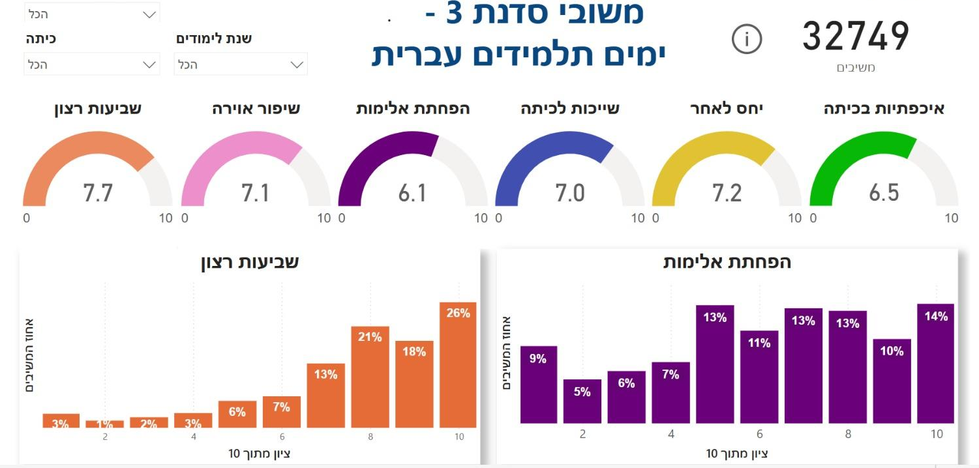
More than 70%
of participants reported
high levels of satisfaction with the workshop
52,690
respondents
Student Feedback
3-Day Workshop
(Jewish sector Schools)
Satisfaction
Improved Classroom Atmosphere
Reduced Violence
Sense of Belonging
Respect for Others
Caring in the Classroom
Overall, how satisfied were you with the “Matzmichim” workshop held in your class?
Following the workshop, students reported less violence and fewer hurtful interactions in the classroom
% of Respondents.
% of Respondents.
Score out of 10
Score out of 10

Slide 3

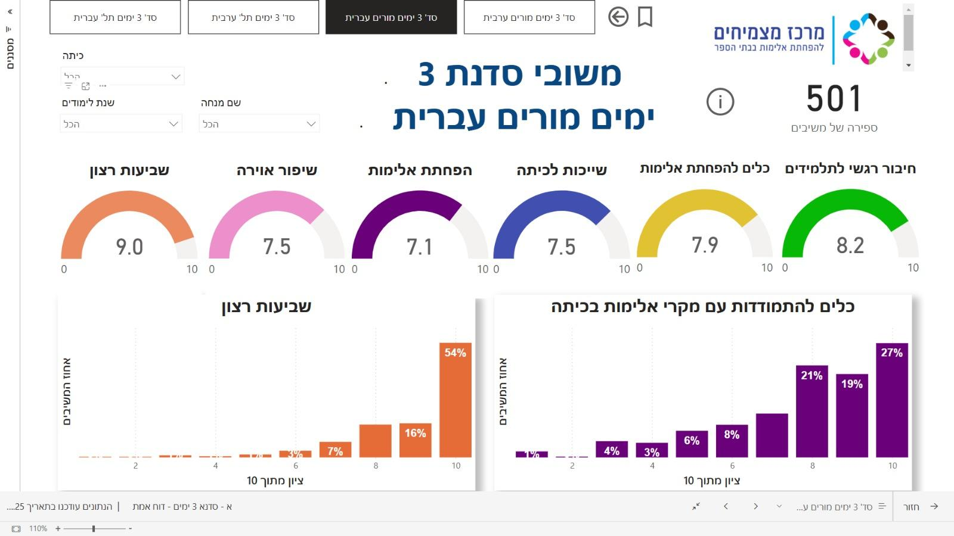
501
respondents
67%
of teachers reported gaining practical tools to address violence in the classroom
Teacher Feedback
3-Day Workshop
(Jewish sector Schools)
Satisfaction
Improved Classroom Atmosphere
Reduced Violence
Sense of Belonging
Respect for Others
Caring in the Classroom
How satisfied are you with the Matzmichim workshop, designed to reduce aggression and alienation, held in your class?
The workshop gave me practical tools for effectively managing incidents of aggressive behavior in the classroom
11%
% of Respondents.
% of Respondents.
Score out of 10
Score out of 10

Slide 4
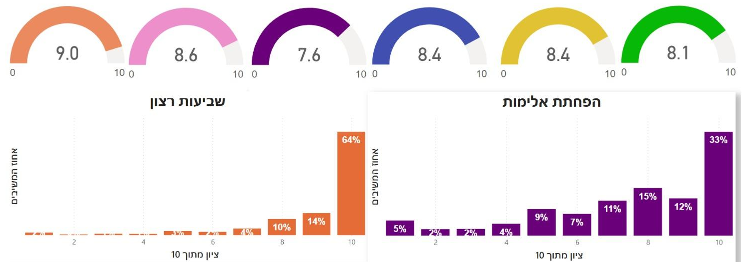
2725
respondents
88%
of students reported
high levels of satisfaction with the workshop
Student Feedback
3-Day Workshop
(Arab sector Schools)
Satisfaction
Improved Classroom Atmosphere
Reduced Violence
Sense of Belonging
Respect for Others
Caring in the Classroom
Overall, how satisfied were you with the “Matzmichim” workshop held in your class?
Following the workshop, students reported less violence and fewer hurtful interactions in the classroom
% of Respondents.
% of Respondents.
Score out of 10
Score out of 10

Slide 5
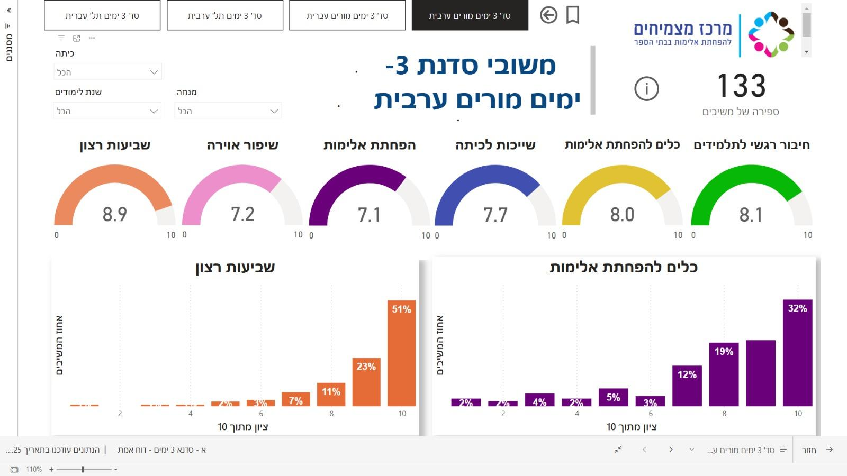
133
respondents
83%
of teachers reported gaining practical tools to address violence in the classroom
Teacher Feedback
3-Day Workshop
(Arab sector Schools)
Satisfaction
Improved Classroom Atmosphere
Reduced Violence
Sense of Belonging
Respect for Others
Caring in the Classroom
How satisfied are you with the Matzmichim workshop, designed to reduce aggression and alienation, held in your class?
The workshop gave me practical tools for effectively managing incidents of aggressive behavior in the classroom
19%
% of Respondents.
% of Respondents.
Score out of 10
Score out of 10

Slide 6
Student & Teacher Feedback“Matzmichim Online” Workshop
Evaluation data collected from students and teachers at the end of the Matzmichim workshop through an anonymous questionnaire. Data updated as of December 25, 2024.

Slide 7
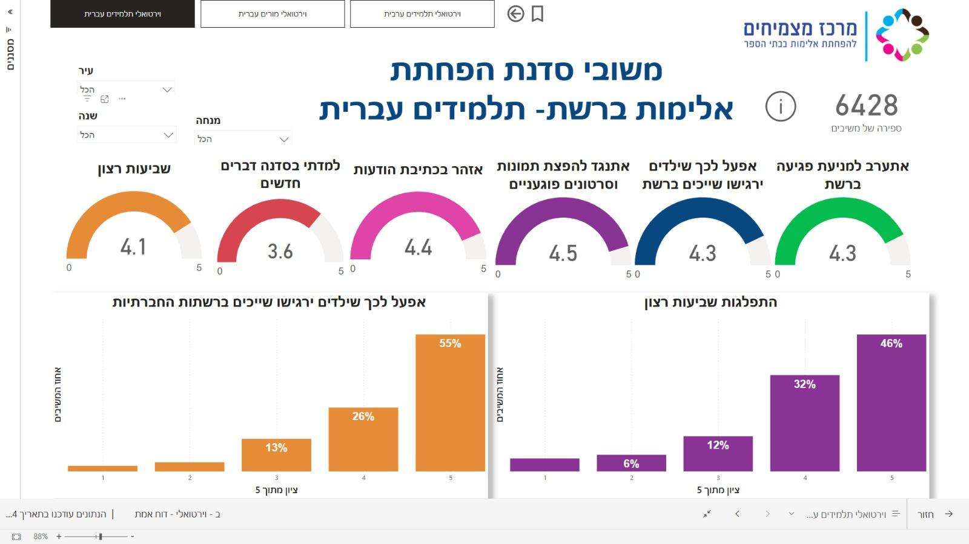
82%
of students said that, following the workshop, they would take action to help other children feel a sense of belonging on social media
6428
respondents
Reduction Workshop student Feedback
(Jewish sector Schools)
Satisfaction
I learned new things in the workshop
I will be careful not to write hurtful messages
I will oppose the sharing of harmful photos and videos
I will act to help children feel a sense of belonging online
I will intervene to prevent online harm
I will act to ensure children feel a sense of belonging on social media
how satisfied were you with the
“Matzmichim Online” workshop held in your class?
% of Respondents.
% of Respondents.
Score out of 5
Score out of 5

Slide 8
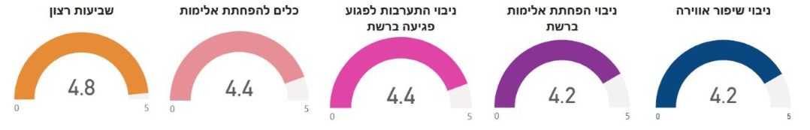
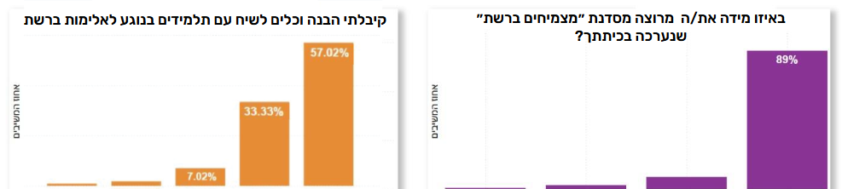
90%
of teachers reported gaining knowledge and practical tools for talking with students about online violence
Reduction Workshop teacher Feedback
(Jewish sector Schools)
114
respondents
Satisfaction
Violence Reduction Tools
Predicted Intervention in Cyberbulling
Predicted Cyberbullying Reduction
Predicted Atmosphere Improvement
I gained knowledge and practical tools for talking with students about online violence
how satisfied were you with the
“Matzmichim Online” workshop held in your class?
% of Respondents.
% of Respondents.
Score out of 5
Score out of 5

